Slide 1


K.RAMAKRISHNAN COLLEGE OF TECHNOLOGY
(AUTONOMOUS), TRICHY.
SNAKE GAME IN JAVA
PRESENTED
DhanaKiran G
230381171-0421025
SUPERVISOR
Mr. M. Saravanan, M.E.,
AP/CSE.

Slide 2
PRESENTATION OVERVIEW
Objective
Project Introduction
Problem Statement
Methodologies (Programming concepts relevant to problem statement)
Architecture of the proposed system
List of Modules
Merits
Results and Discussion
Queries

Slide 3
OBJECTIVE
The objective of this Java program is to create a functional and interactive Snake Game. Here's a clearer explanation of what the program is designed to accomplish a classic Snake Game where the player controls a snake, attempting to eat food to grow longer, while avoiding collisions with itself and the walls of the game area.The main goal is to provide an enjoyable and challenging game experience where the player aims to grow the snake as long as possible by eating food, while avoiding collisions that would cause the game to end.

Slide 4
PROJECT INTRODUCTION
The Snake Game is a classic video game that has been a staple of early computing and mobile devices. The goal of the game is simple: control a snake, eat food to grow, and avoid running into walls or the snake's own body. This project implements the Snake Game using Java and the Swing library for graphical user interface (GUI) and event handling.
This Snake Game project is a fun and educational exercise in programming that demonstrates essential concepts in Java development. It combines logic, graphics, and user interaction to create a classic game experience, making it an ideal project for beginners and intermediate programmers. By completing this project, developers gain hands-on experience with event handling, game mechanics, and graphical rendering in Java, which can serve as a foundation for more advanced game development projects.

Slide 5
PROBLEM STATEMENT
The snake's movement should be controlled using the arrow keys, and the game will end if the snake collides with the boundaries or its own body. The game should feature randomly spawned food items that the snake eats to grow and increase the player's score. The game will also display the current score throughout the gameplay, and upon game over, show the final score.
The program must implement key features such as a game loop that continuously updates the game state, including movement, food generation, and collision detection. The user interface will be built using Java's Swing library, and the game should handle basic event-driven programming to capture user input and update the game state in real time.

Slide 6
METHODOLOGIES
1.Object-Oriented Design (OOD):
SnakeGame (Main class): Initializes the game window and starts the game.
GamePanel: Contains the game logic such as snake movement, food spawning, collision detection, and score management.
MyKeyAdapter: Handles user input, specifically the keyboard arrow keys, to change the snake's direction.
2.User Interface and Experience (UI/UX):
Responsive Controls: The user interface is designed to be simple, with easy-to-understand controls using the arrow keys. The snake’s movement is smooth, and user input is immediately reflected in the game state.
Game Over Screen: The game over screen appears clearly and prominently after the snake dies, showing the final score, so players know their performance.

Slide 7
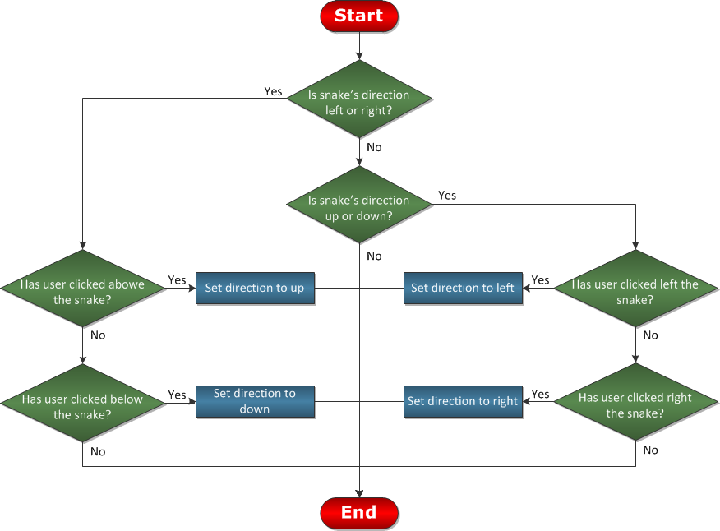
ARCHITECTURE OF THE PROPOSED SYSTEM

Slide 8
LIST OF MODULES
Game Initialization Module
Game Loop management Module
Snake Movement And Control Module
Colision Detection Module
Food Generation and Scoring Module

Slide 9
MERITS
1. Simplicity and Fun Game Design:
Classic and Engaging: The Snake Game is a well-known and addictive game that has stood the test of time. It provides a fun, fast-paced experience that can be enjoyed by players of all ages.
2.Simplicity in Code and Low Resource Usage:
Lightweight Game: The game is relatively simple and doesn’t require extensive computational resources, making it accessible on almost any machine that supports Java.
3.Educational Value:
Perfect for Beginners: This project is excellent for beginner programmers as it reinforces fundamental concepts like loops, conditionals, and user input handling in a fun, interactive context.

Slide 10
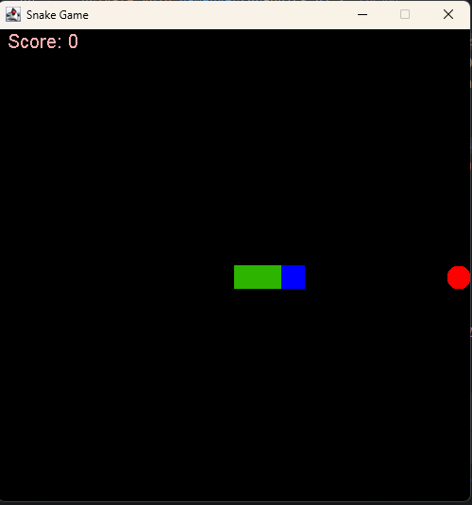
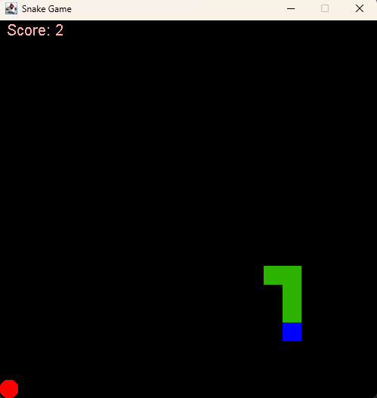
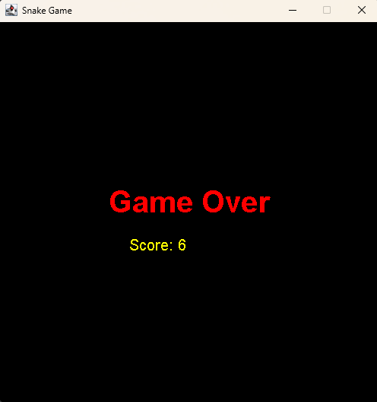
RESULTS AND DISCUSSION

Slide 11
QUERIES ?

